Slide 1

IBM Data Science Capstone Project Recommender System for identification of Amenities in the vicinity of Hi-Tech City in Hyderabad using Four Square Application Programming Interface (API) Data by Dr.V.Venkat Ramayya. M.Tech (Hons), Ph.D

Slide 2
Problem Definition
In this Capstone Project of Coursera, it is proposed to develop a recommender system for HITEC City through identification of different types of amenities and categorise them

Slide 3
Objectives
To collect required geospatial data to identify amenities in the vicinity of Shilparamam, HITEC city.
To collect geoJSON data for the chosen study area.
To collect Four square API data thorough general and premium calls to harness the information about the venues and their categories in the vicinity of HITEC City, Hyderabad.
To recommend venues to the users based on ratings and other statistics for a chosen venue category.

Slide 4
Target Audience
People seeking different types of best amenities such as restaurants, coffee shops, furniture malls, textile shops etc in the vicinity of the study area.
As the recommender system will aim to identify different types venues around a chosen neighbourhood, this data would be useful for business expansion who would like to set up their new centres to promote their business.

Slide 5
Data Collection
The geospatial data of the HITEC city around Shilparamam is collected using https://mygeodata.cloud/map/ in the form of .osm file (open street map). to geoJson file using https://mygeodata.cloud/converter/ to get the information about the different types of attributes of the study area.

Slide 6
Sequence of steps
Install required packages
Collect .osm file of the study location
Convert the .osm File to geoJSON file
Extract Amenity Points in the study area from the geoJSON file.
Read Amenities into a Pandas Data Frame and Edit the data for missing values.
Get the Neighbourhood data by Four Square Call (26 Neighbourhoods)
At this point, the Shilpakala vedika has been chosen to identify and Explore the nearby venues around these 26 Neighbourhoods (5175 nearby venues are returned by Four Square) and prepare data frame.

Slide 7
Sequence of steps – Contd…
Group the above data based on Neighbourhood and count unique categories. (73 No’s)
The frequency of occurrence of top 5 venues listed by Foursquare in each of those Neighbourhoods is calculated.
N^{th} (1st to 10th) Most common Venue for each of these Neighbourhoods is assessed.
Word Clouds are prepared both for ‘Venue’ and ‘Venue Category’ to identify the most listed venue for 1st, 2nd and 3rd Common venue.
Word cloud for the Venue Category
Perform the cluster analysis for the Neighbourhoods.
Restaurants are explored (as this venue is found to highest frequency) through premium calls for getting information about tip count and other venue statistics. Graphs are prepared for recommending venues for the Category ‘Restaurants’ based on ‘Tip Count’, ‘Ratings’ and ‘Likes’ .

Slide 8
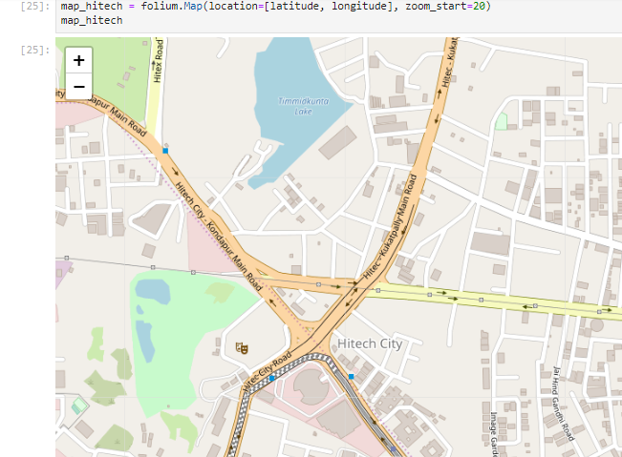
HiTech City, Hyderabad from Folium

Slide 9
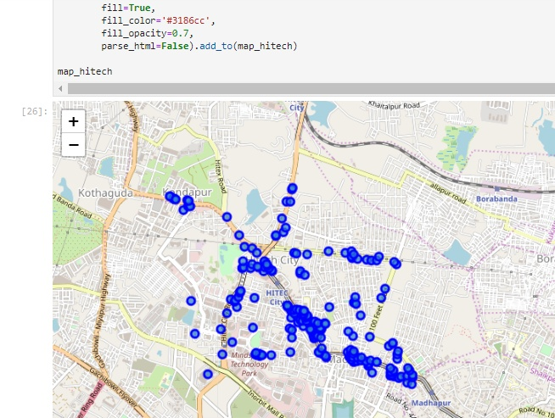
HiTech city with Neighbourhoods around shilpa kala vedika

Slide 10
RESULTS

Slide 11
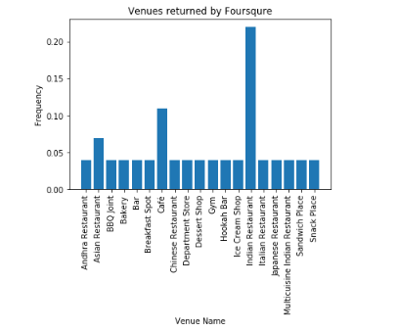
Frequency of Venue categories returned by Foursquare

Slide 12
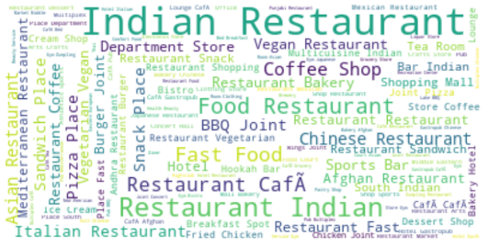
Venue Categories in a Word Cloud for first three common venues of Neighbourhoods around Shilpa Kala vedika in HiTech City

Slide 13
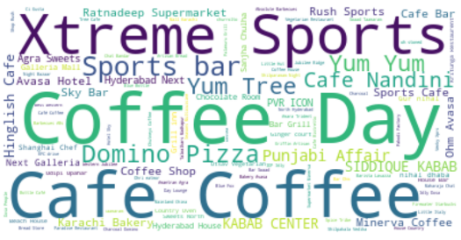
Venues names in a Word Cloud for first three common venues of Neighbourhoods around Shilpa Kala vedika in HiTech City

Slide 14
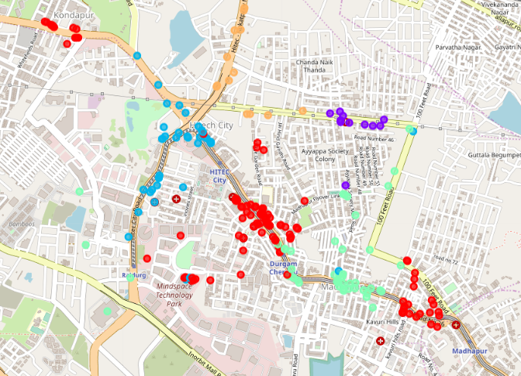
Clusters of Neighbourhoods in Hitech City

Slide 15
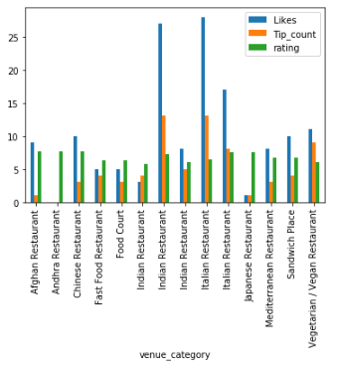
Results of Premium calls

Slide 16
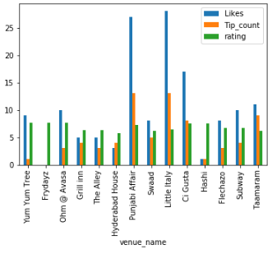
Results of Premium calls

Slide 17
Summary
The neighbourhoods in the vicinity of HiTech city were explored around Shilpa Kala Vedika (26 No’s). Further, the venues in the vicinity of the above neighbourhood was explored using venues/explore call method. Restaurants were found to be very predominant among the other categories. Hence it was decided to explore the Restaurants through premium calls. It was found that the Little Italy of Italian restaurant category and Punjabi Affair of Indian Restaurant category were found to have good ratings, tip counts and likes of all venue categories. Both these venues were indexed as ‘moderate’ price by the users.

Slide 18
Conclusion
It can be concluded that the Four Square API is a good tool for exploring the neighbourhoods for different types of geographical features.
Premium calls will help us to get the detailed information like venue stats, likes, ratings, images etc.
Word Clouds developed from first most to third most common venues under each neighbourhood have helped to understand most frequent venue categories and venues in the HiTech City as listed by Four Square.
In the present work, due to non availability of demographic data, the analysis is limited to the results of Four Square API. Better recommender system models can be developed if it is possible to integrate the demographic data.

Slide 19
References:
1 https://mygeodata.cloud/converter
2 https://foursquare.com
3 https://stackoverflow.com
4 https://geeksforgeeks.org

Slide 20
Thank You

